Slide 1
BCS
Past, Present and Future
Ray Long
President, BCS March 2017
O

Slide 2
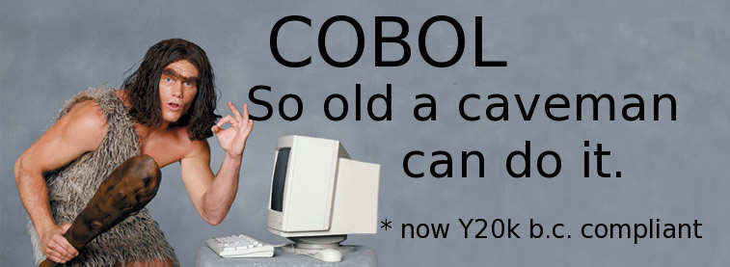
Image Credit: ‘caveman_2’, https://www.flickr.com/photos/kc-bike/2398970429/
https://creativecommons.org/licenses/by-nc/2.0

Slide 3
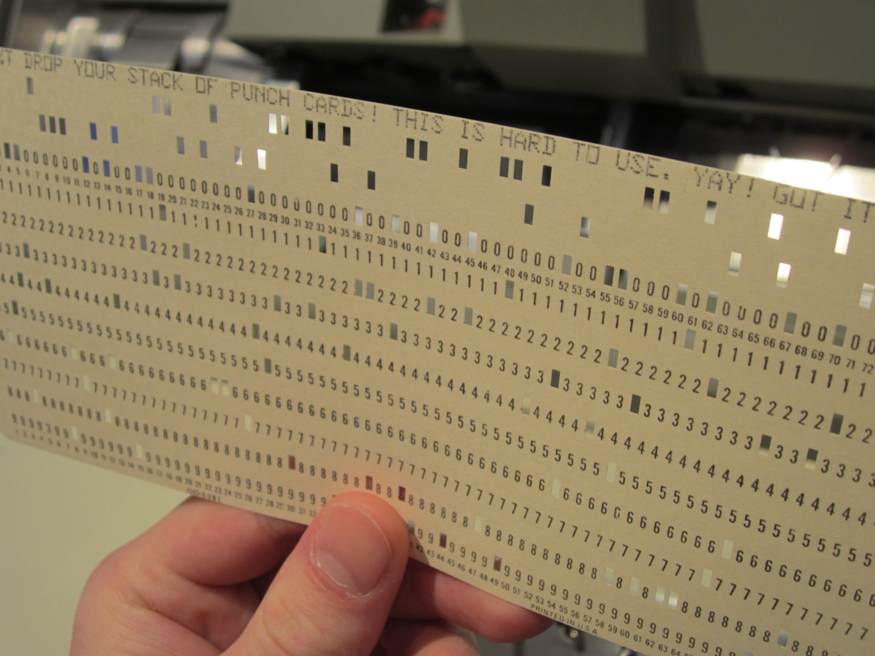
Image Credit: Ann Lusch, Living Computer Museum, Seattle, ‘Computer punch card’,
https://www.flickr.com/photos/38659004@N03/9491629460 https://creativecommons.org/licenses/by-nc/2.0

Slide 4
‘I consider winning one of the most prestigious awards from BCS, as a mile stone in my academic career. Also I highly recommend BCS for those who wish to acquire professional IT knowledge and experience.’
Dushani Dunukara Winner of the PROMS-G Award 2013

Slide 5
Image Credit: http://www.bcs.org/

Slide 6
“We are currently preparing students for jobs that don’t yet exist
using technologies that haven’t been invented in order to solve problems we don’t even know are problems yet.”
Did You Know?, licensed by Karl Fisch, Scott McLeod, and XPLANE under a Creative Commons Attribution Non-Commercial Share-Alike license 2014 Re-Mix by Katy Scott

Slide 7
“The amount of new technical information is doubling every 2 years.
For students starting a 4 year technical degree this means that half of what they learn will be outdated by their third year of study.”
Did You Know?, licensed by Karl Fisch, Scott McLeod, and XPLANE under a Creative Commons Attribution Non-Commercial Share-Alike license
2014 Re-Mix by Katy Scott

Slide 8
BCS – The Past
Why did you join the BCS?
How has it helped you during your career?
What sort of further volunteering role might you consider?

Slide 9
BCS, The Chartered Institute for IT
Who are we?
The global awarding organisation for IT qualifications and certifications
Providers of lifelong learning in IT and digital capability for all members of society.
What is our mission?
Create a framework of excellence from which all members of society can build their competency and confidence in IT
Empower everyone to be ready for, and optimise, their digital future
Help organisations and people to thrive in the digital world, and harness the driving force of technology.
How do we achieve it?
Develop an international IT framework
Identify skills gaps and risks in the industry.
Provide training, consultancy and assessment services to meet those needs.
Anticipate developments and progress in today’s IT landscape and equip people with the skills to thrive in tomorrow’s.

Slide 11
Strategy
There are 3 ‘pillars’ that we believe are simple, powerful and relevant to our new purpose. They will be delivered through our programs and activities:
Community
BCS Pillars
‘Making IT good
for society’
Excellence
Leadership

Slide 12
Strategy - how do BCS do this?
There are 3 ‘pillars’ that we believe are simple, powerful and relevant to our new purpose:
Pillars | Rationale
Pillar 1. Community > We build a powerful community that can help us achieve our purpose > Our community goes beyond IT | We need to galvanise and purpose the communities both inside and outside of our organisation to help us to create real impact in our sector and the wider world
Pillar 2. Excellence > We help IT practitioners meet meaningful standards that deliver results > Our standards are relevant, valuable and sought after | We need to drive excellence in our sector, offering professionals the means to succeed, whether information and guidance, access to knowledge & experience, or tools & services
Pillar 3. Leadership > We inspire the debate around IT and foster learning for the good of society > Our role is independent & respected | We need to use what we know to lead the sector, tackling the thorny issues that worry society and offering a relevant, informed and inspiring point of view.

Slide 13
Key Challenges Focus and engagement on society
A focus on goals that affect society, where BCS can make a difference
Helping those in information and technology build a digital world for real people
Ensuring everyone can be exposed to and choose to study computing and computational thinking
Inspiring the informatics community to create a health and care environment built around the individual
Getting personal data back under control for people, unlocking the benefits

Slide 14
Key Challenges Community at the heart of challenges
In the past year we have…
Delivered exciting events to debate critical issues for society and IT
Built and piloted new ways for members to get together at a local level
Launched an online hub showcasing the challenges, how to get involved
Where we go next…
Rolling out these new formats across branches and specialist groups
Focusing our member communications on how they can Make IT good for society

Slide 15
IT Impact Event
This IT Impact event was held on 9 June in Leeds.
For the first time, BCS successfully trialled Periscope (www.periscope.tv) with a live stream of this event

Slide 16
Education
Information Technology
Use technology purposefully to create, organise, store, manipulate and retrieve digital content
Digital Literacy
Recognise common uses of information technology beyond school. Use technology safely and respectfully
ICT
Computer Science
Notes:
The old ICT curriculum has been replaced from September 2014 with the new Computing Curriculum
This new subject has three distinct elements to it:
Information technology – Using technology to create contect e.g researching for a project, publishing content (this could be producing a blog, or sharing a Powerpoint presentation), producing graphs to represent data etc. This was part of the old ICT curriculum so probably feel most comfortable with.
Digital Literacy – Within this strand, pupils will learn to use and express themselves, and develop their ideas through information and communication technology. In practice this could mean helping pupils understand the risks and benefits of interacting online, and helping them to shape their behaviours to be a good digital citizen. This could be discussing with pupils what makes a good password and why it is important to keep your passwords secret, how to make the best of using social media, effective search techniques or tips to write a good email. This was also part of the old ICT curriculum You can find free material for parents on schools on the Internet Matters website
Computer Science – This is the new part of the curriculum. This is the focus of Barefoot and today’s session.
As pupils progress through the Computing curriculum, we want them to sit within the centre of these three circles, calling on elements within each strand enabling them to understand and use technology effectively and responsibly.

Slide 18
BCS – The Present
Do the three ‘pillars’ miss out anything important?
How could you support our four campaigns?
What is currently going well or posing a challenge?

Slide 19
BCS – The Future
“The rise of the ‘individualistic’ culture and growth in working hours has resulted in a growing reluctance to volunteer or join a ‘club’. Many Associations are suffering from declining engagement and shortage of volunteers, particularly young volunteers, for their governance structures …”
21st Century Professional Association, A view of what a 21st Century Professional Association may look like and the factors that affect its shape,
look and feel, Lenton & Associates, 2009

Slide 20
BCS – The Future
“… Associations need to identify and focus on the 2/3 key reasons why people should join their Association. Perhaps they need to de-clutter their proposition (and the costs that go with it) …”
21st Century Professional Association, A view of what a 21st Century Professional Association may look like and the factors that affect its shape,
look and feel, Lenton & Associates, 2009

Slide 21
BCS – The Future
“… Success in thinking these issues through is having a clearer picture of where your Association needs to be in 5 to 10 year’s time and the ability to plan how you get there.”
21st Century Professional Association, A view of what a 21st Century Professional Association may look like and the factors that affect its shape, look and feel, Lenton & Associates, 2009

Slide 22
Deputy President Nomination Statement
A long-term vision of what sort of organisation we will need to be by the end of the decade
More when it comes to influencing, lobbying and sharing opinions, and explaining and commenting robustly on matters which affect our profession
Further ways of promoting our profession and its standards
Attract more young people and extend the reach of our Institute further into the digital world of ‘new IT’
Make our profession more diverse, inclusive and open to all

Slide 23
BCS – The Future
What are the 2-3 key reasons for joining BCS today?
What would make us more attractive to non-members?
What should we look like in 5-10 years’ time?

Slide 24
The Challenge
For decades we have been bombarded with books, reports and metrics on IT Project Failure:
75% of IT Projects fail – severe cost or schedule overruns, cancellation or don’t work (Gartner Group).
70% of organisations have experienced at least one project failure in the last year (KPMG).
31% of projects will be cancelled before they complete (Chaos Report, Standish Group).
€142bn wasted in IT Project Failure (McManus & Wood-Harper, BCS).
‘Common causes of Project Failure and their remedies’ (NAO).
‘Lessons from a Decade of IT Project Failure’ (IEEE) .
And we are still not in a good place – even after decades of working the problem.

Slide 25
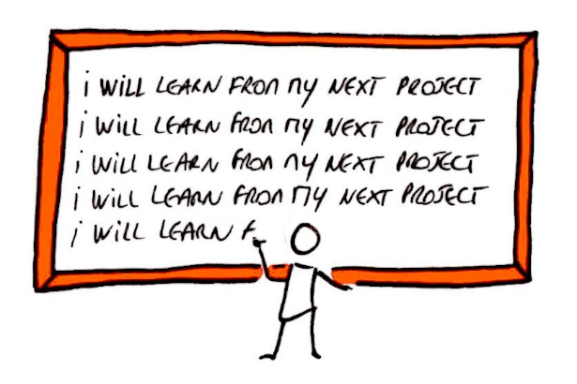
Image Credit: angeline veeneman, ‘Project lessons learnt’, https://www.flickr.com/photos/121617458@N03/ https://creativecommons.org/licenses/by-nd/2.0/

Slide 26
The Cause - Driving up the success of IT projects, with a positive focus on what we know to be the critical factors in delivering successful outcomes.
The Aim - Making project failure a choice – not, as it is seen at the moment, an accepted inevitability.
Impossible? Maybe. Big and bold, certainly. But we will never know if we can do it until we do it.
The Means - The adoption of proven principles, fresh mind-sets and actions which we know to work.
/

Slide 27
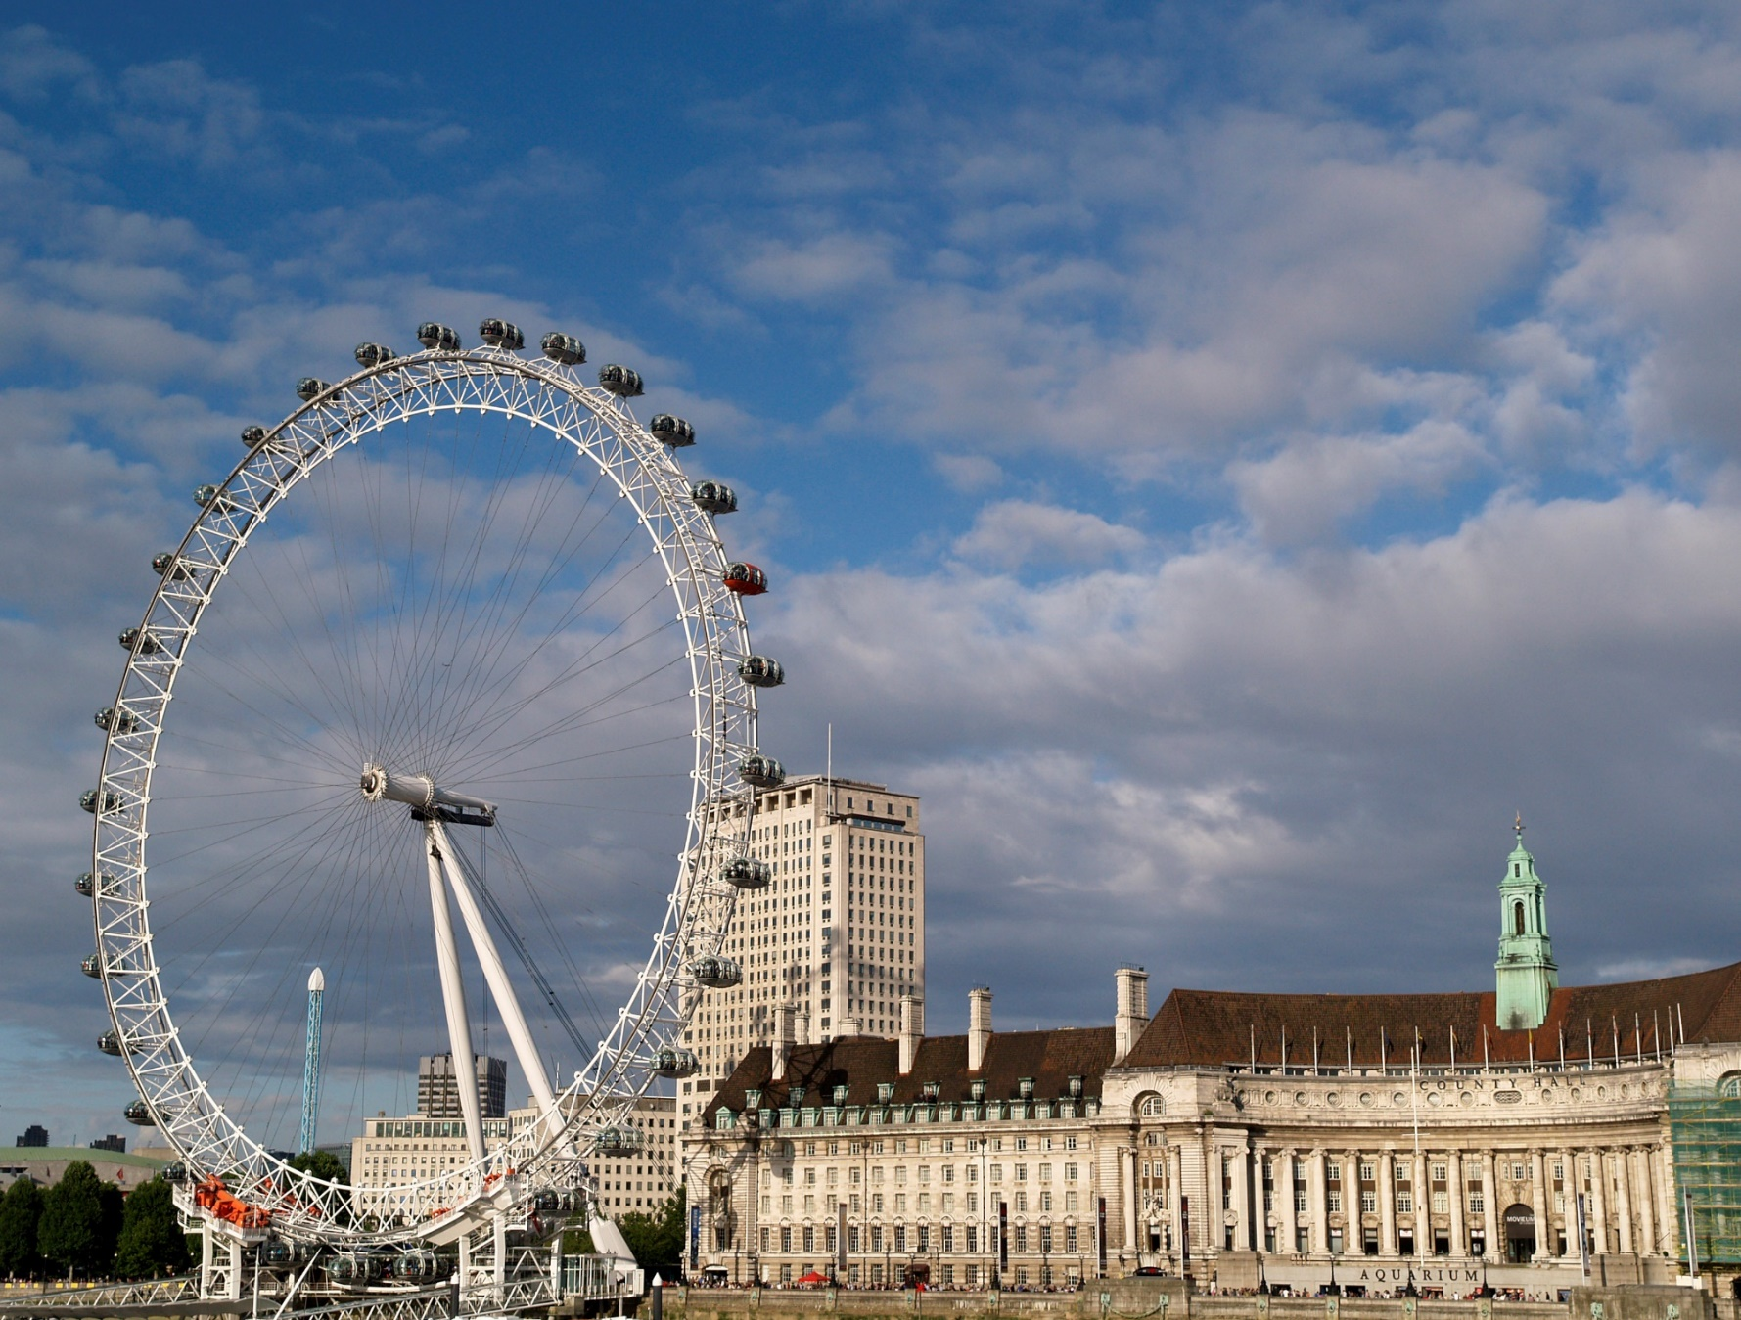
/
Image Credit: Manolo Blanco, ‘London Eye – London’, https://www.flickr.com/photos/manoloblanco/14213606378/ https://creativecommons.org/licenses/by-nc-sa/2.0/

Slide 28
Seven Action Areas
This is my theme for my year as President.
Bring together the best experts, leaders and practitioners to support and help us.
Focus on what we know to be the critical factors in delivering. successful projects – the right People, Leadership, Behaviours and Choices.
Expand our SFIA-Plus Skills Framework e.g. to include Personal Effectiveness, Emotional Intelligence, Communications Skills, Collaboration Skills and Leadership Skills.
Measure project success in meaningful terms.
Ensure that IT is an integral part of, and driving, ‘The Business’.
Deliver and publicise case-studies, examples and stories of success.
/

Slide 29
IT Projects Success
What is your definition of a successful IT Project?
What still stops us from achieving this every time?
If we could eradicate IT Project failure, what would be the first step we would need to take?

Slide 30
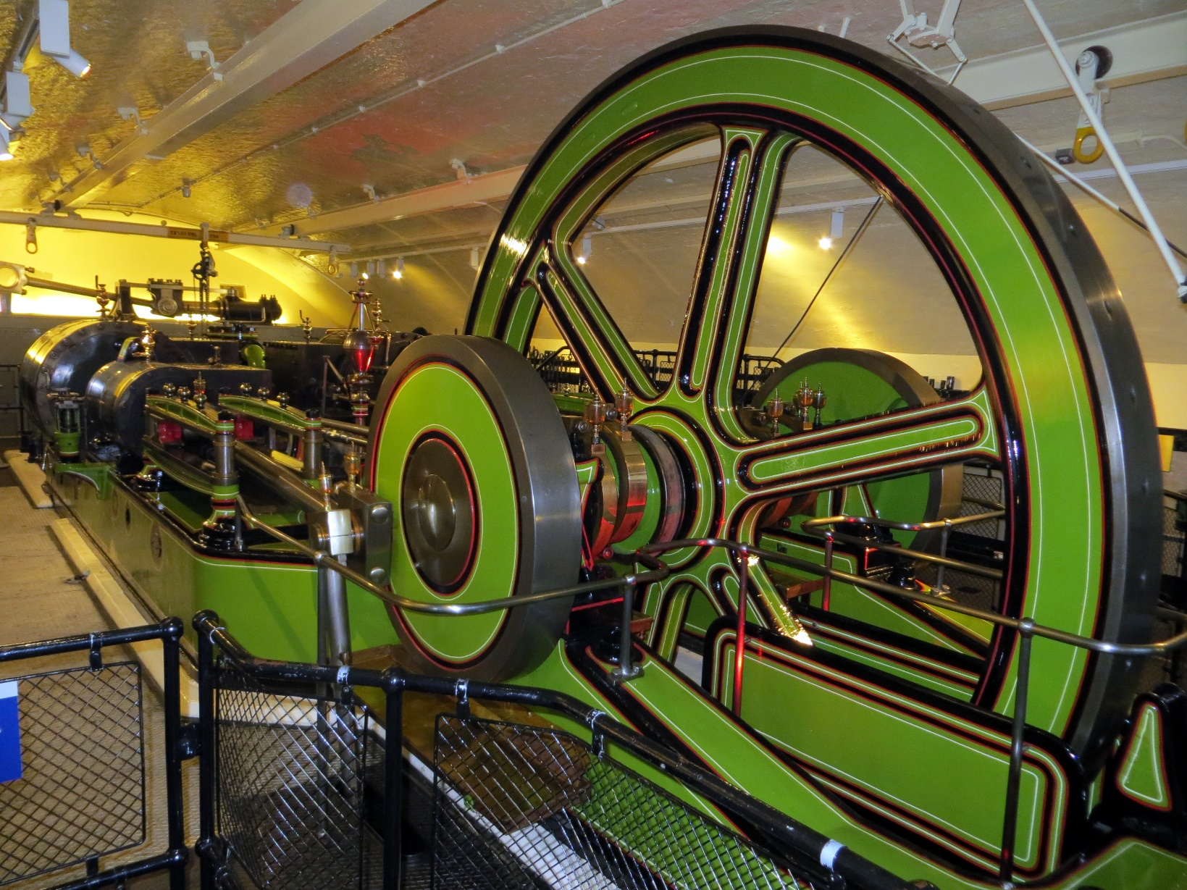
Thank You!
Image Credit: Charles D P Miller, ‘Tower Bridge Engine Rooms’, https://www.flickr.com/photos/cdpm/8255968876/
/
https://creativecommons.org/licenses/by/2.0/

Slide 32
Thank you
any
Questions?
Ray Long
President, BCS March 2017

